Slide 1

A Circular Solution for Plastic Waste in Laos

Slide 2

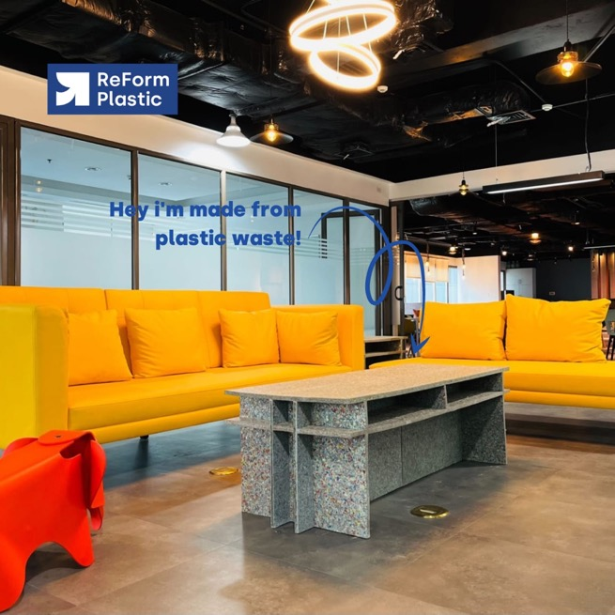
We are a social business that aims to offer a circular solution to plastic waste in Laos by transforming it into valuable, durable, and versatile products.
Based in Luang Prabang, Laos
A franchise of ReForm Plastic

Slide 3
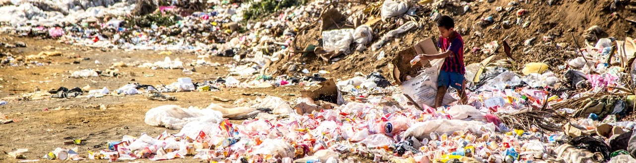
In Asia – Pacific region
In Laos
87,000,000
metric tons of plastic
consumed annually
25%
average rate of plastic recycling
65,250,000
metric tons of plastic is not collected or processed
0.842 kg
waste generated per person per day
12%
of household waste is plastic
10%
average rate of plastic recycling
Souces: United Nations Environment, IETC, AIT, ISWA (2017), Asia Waste Management Outlook

Slide 4
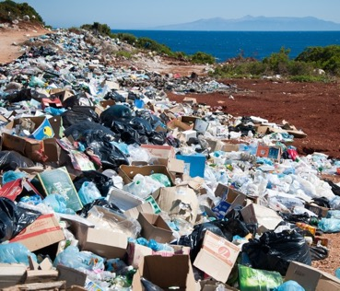
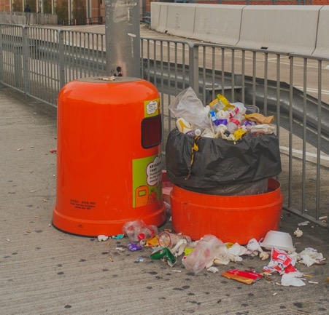
Currently most plastic waste is facing these challenges
No value
No sorting
No collection
No processing
Our solution gives all plastic value and what was once discarded into our environment can now be made into something beautiful

Slide 5
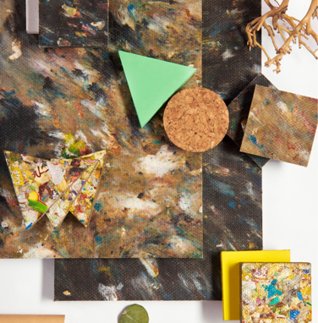
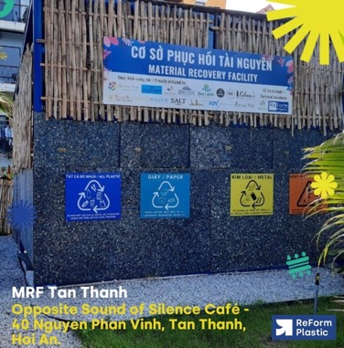
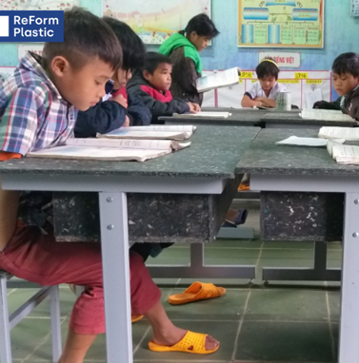
We address these issues through:
Value Creation: waste becomes a locally used resource in a fully circular system inclusive of the informal sector
Sorting Program: initiating waste sorting programs with businesses, schools and the city authority to extract more value from waste
Collection Schemes: providing better ways to collect materials across the city
Value-added Processing: the process is simple and circular. Our products are safe, tested and create an impact

Slide 6
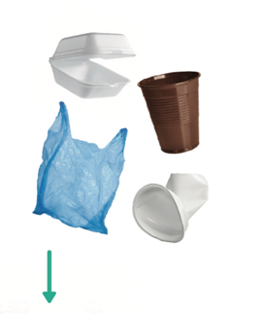
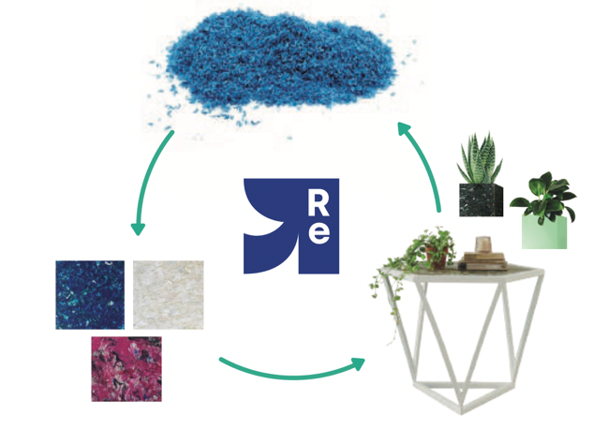

How it works

Slide 7
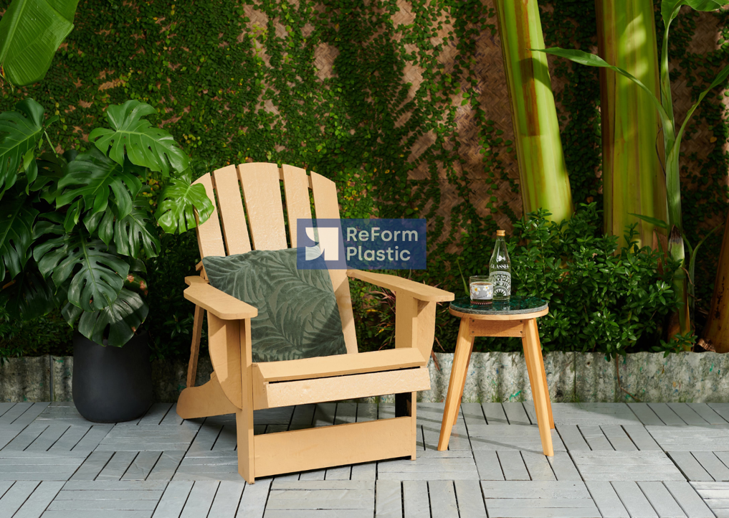
How is our approach different?
We take 100% of plastics: Unlike others, we convert any types of plastic into uniquely crafted, functional products.
Affordable solutions: Through our cost-effective process, we can create useful products for any budget.
Social inclusion: we not only better the planet but also empower local waste workers through our integrated approach
Circular life cycle: our process is entirely circular, we take back old products and convert them into something new again

Slide 8
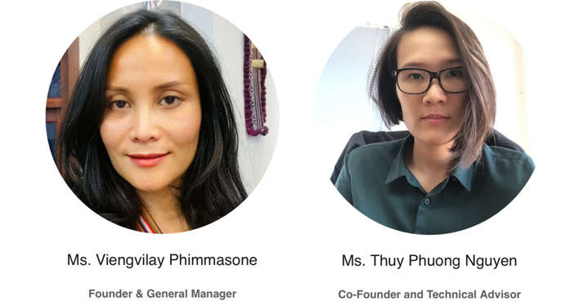
Our team

