Slide 1
Greener Wheels
Logistics Low Carbon Analytics Software

Slide 2
Hello.
Gooi Project Manager
Jian Tech Lead
White Room is a software agency based in the heart of Georgetown, Penang.
mobile apps, web apps
software integration
tech consultancy
www.whiteroom.work
WHITE ROOM ANALYTICS PLT (LLP0019382-LGN)

Slide 3
Problem Statements
Lack of
environmental impact measurements
from the logistics industry.
Efficient delivery with low carbon.

Slide 4
Objectives
Assessment
To develop carbon footprint system that provide in depth analysis on fleets and trips Provide fair and accurate carbon footprint rating reports for public / potential investors.
Simulation
To develop a model to predict the carbon savings based on user changes Assist better transportation planning, environmentally and financially.

Slide 5
A sustainable net-zero/low carbon solution to address a documented urban challenge.
Implemented by April 2024.
The USASCP is a whole-of-government effort that includes participation from the Departments of State, Commerce and Transportation, NSF, USAID, USTDA and DFC.

Slide 6
Why logistics in Malaysia
World bank 2019: Total CO2 from Malaysia is 396.11 mil tonne, where transportation contributes 65.31 mil tonne, which is 16% of Malaysia total CO2
KPMG 2021: transportation - 17% of total CO2 emission in Malaysia and increasing
70% logistics are from SME

Slide 7
Using Greener Wheels
Set Data Source
Assessment
Simulate
Implement
Routes, schedules, vehicle models and engines, load, etc
GPS (Close-to-realtime) tracking, route information
Vehicle emission data
Route / schedule / overview performance
Carbon emission, heatmaps
Delivery costing
Plan transport service with routes, schedules, vehicles, etc
Reports and comparison with existing routes
Change policy, schedules, routes, etc
Improve earning and efficiency
Earn carbon credits

Slide 8
Stakeholders Engagement Roadmap
Now
1H 2023
2H 2023
1H 2024
2H
2024
2H
2024
Award
Realise
Recognise
Record
Report
Reduce
Partnership :
USASCP
National Government
State Government and Agencies
Private Sector
Awareness :
Webinars/events for companies with own/subcontract logistics
Participate in Green and Sustainable State Government and Agencies events
Agreement :
Private sector to advocate and agree to pilot
Support from Green and Sustainable State Government and Agencies
Preparation :
One company to start discussions and collect data
Showcase a prototype with private sector with State and National Government
Pilot :
Company to pilot collection and analysis of data on Greener Wheels platform
Acknowledgement from State and National Government
Execution Programs :
Get participation from more private sector companies
Present to State Government on findings

Slide 9
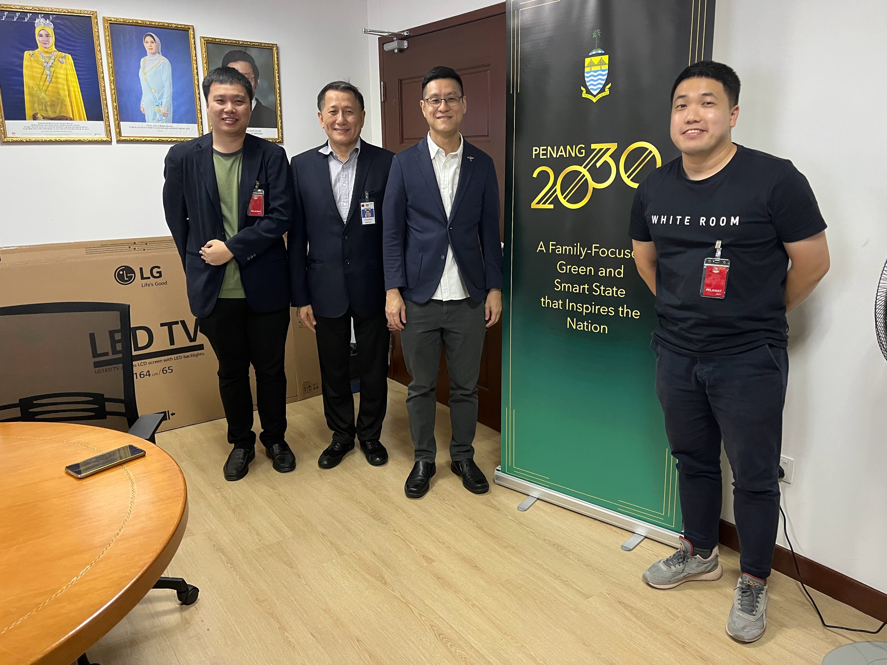
Meeting with EXCO Penang

Slide 10
Vision for change
Carbon tax and credit
Bursa launch Voluntary Carbon Market (VCM)
Low Carbon Mobility Blueprint
Adoption of EV
Reduce GHG
Compliance
ISO-14064 scope 3
Exposure Draft IFRS S1 General Requirements for Disclosure of Sustainability-related Financial Information
Notes:
WIP

Slide 11
Thank you!
Gooi Liang Zheng; gooi@whiteroom.work
Jian Chia; jian@whiteroom.work
www.whiteroom.work
WHITE ROOM ANALYTICS PLT (LLP0019382-LGN)

Slide 12
Team Composition
White Room; Delivery Team
Software system implementation, hardware installation in Malaysia
Penang Green Council; Advisor
GPS Fleet; Partner
Environmental expert in Penang
Expertise in logistics management system
United Cities; Advisor
USM; Advisor
Expertise in city planning in multiple regions.
Academic research on data models

