Slide 1
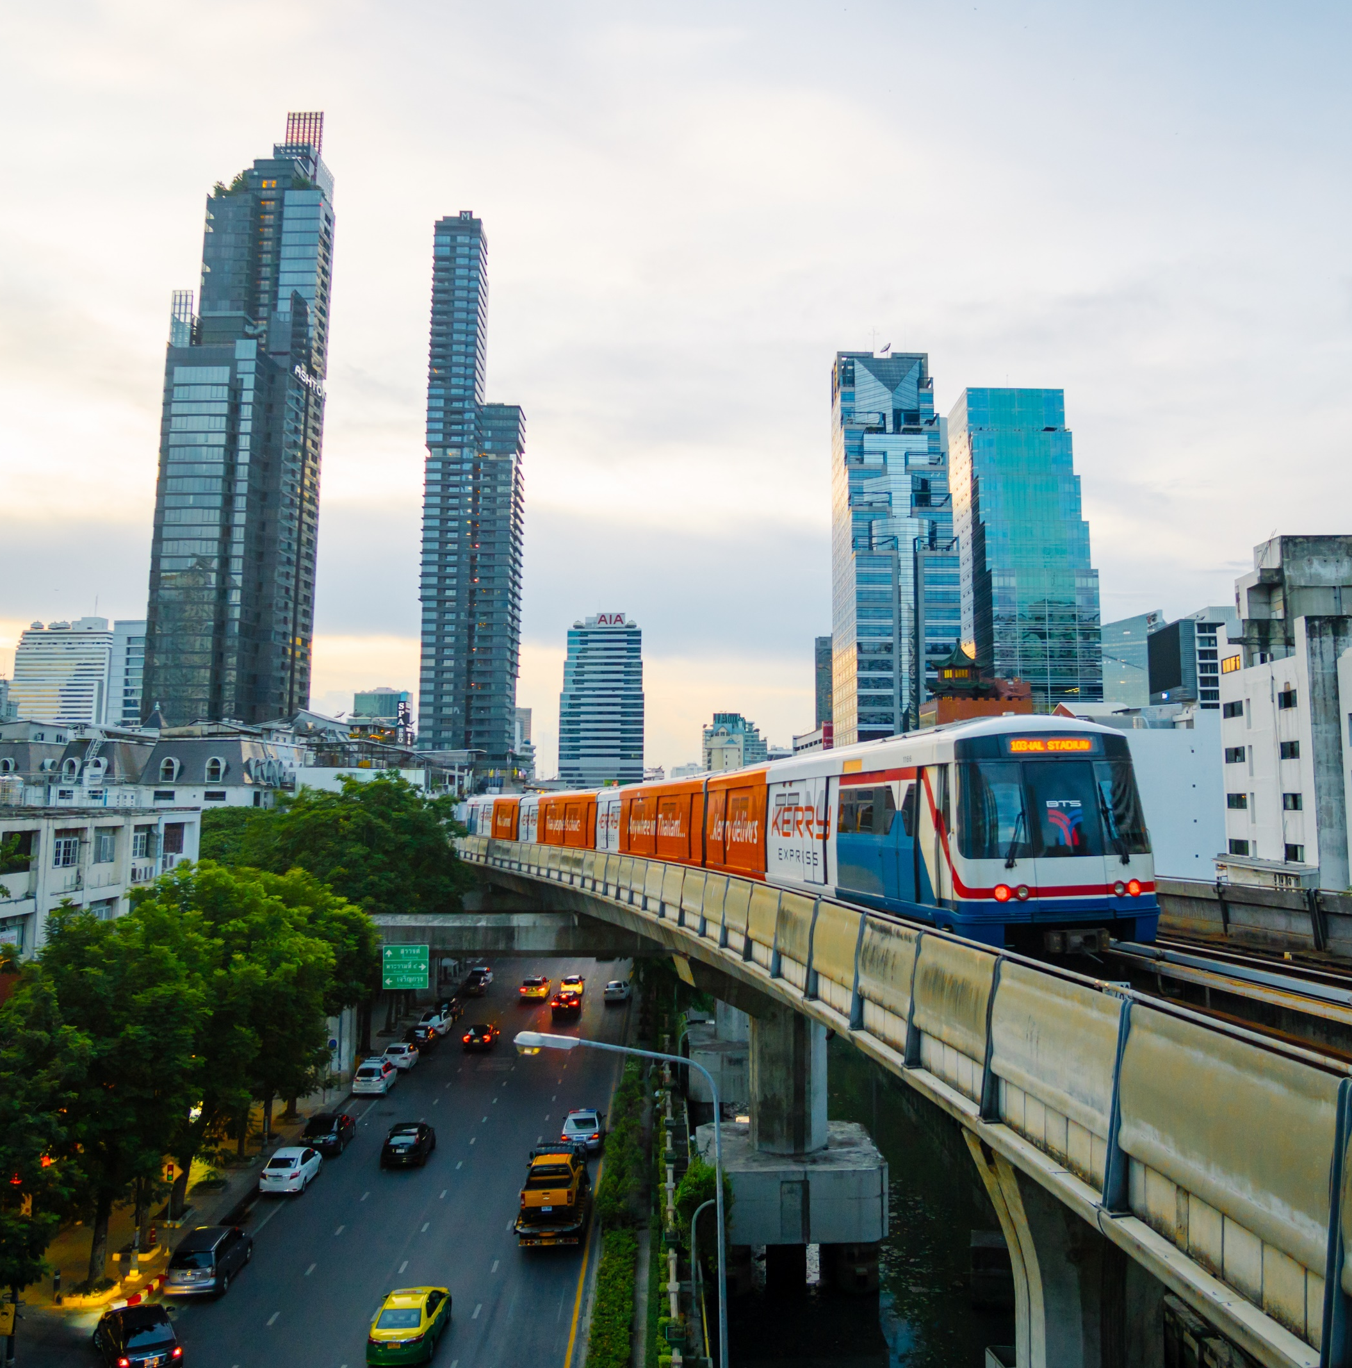

Smart Mobility: Working with the Private Sector
November 18, 2020

Slide 2
USTDA’s Tools
Project Preparation
Partnership Building
Feasibility Studies
Technical Assistance
Pilot Projects
Engineering and Design
Reverse Trade Missions
Conferences
Workshops

Slide 3




Transportation Sector
Railways
Aviation
ITS, Highways & Mass Transit
Ports & Shipping

Slide 4
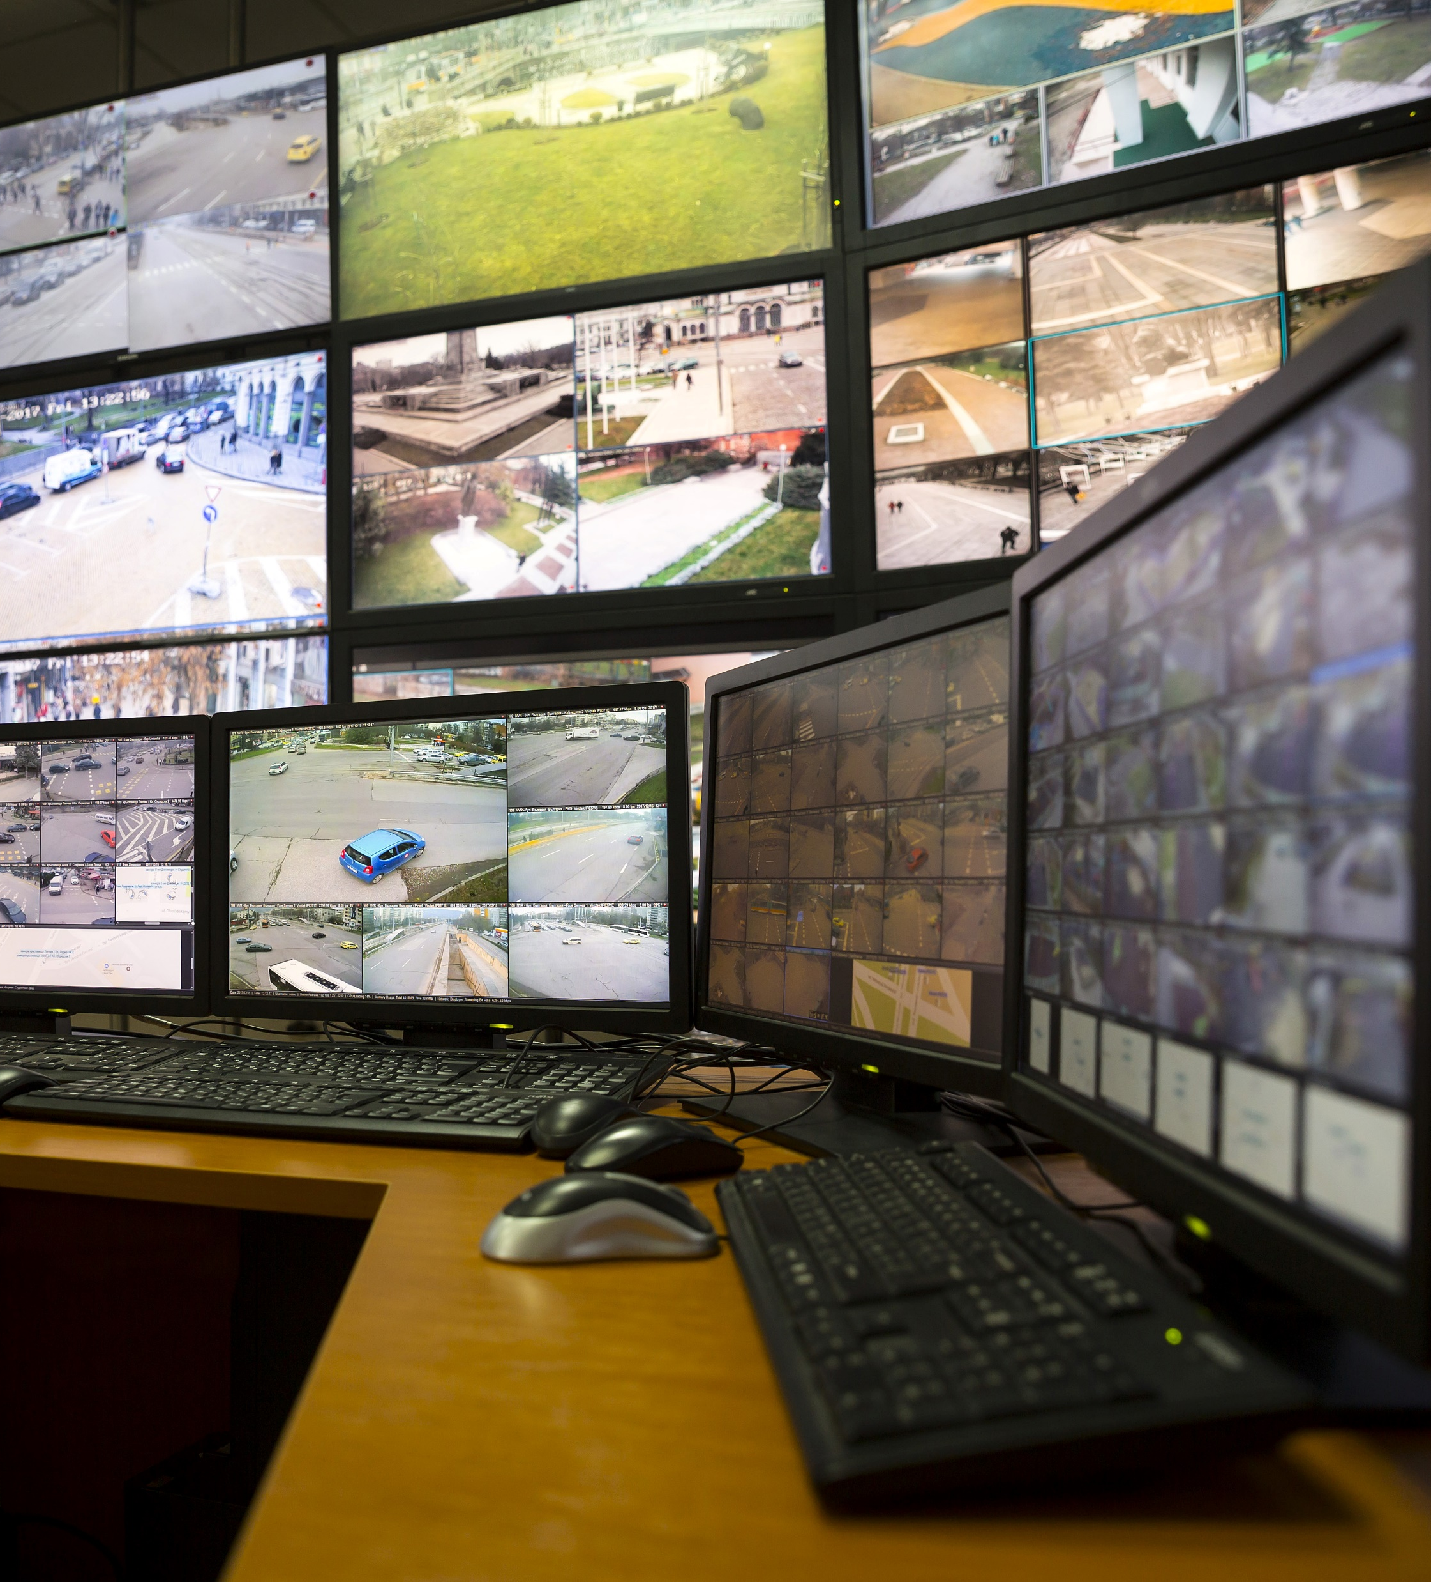
Advancing Smart Transportation Infrastructure Solutions
  Traffic control centers & traffic management solutions
  Intelligent transportation system (ITS) planning & upgrades
  Mass transit network planning
  Bus rapid transit (BRT) systems
  Traveler information systems
  Multimodal system coordination
  Integrated ticketing and fare collection systems

Slide 5
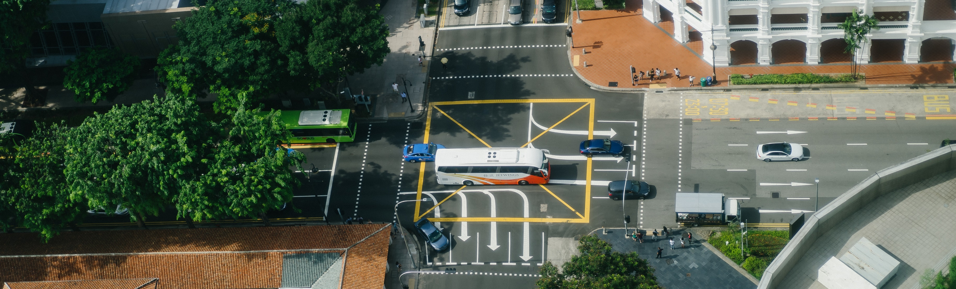
Cebu City, Philippines
USTDA is supporting the development of an Intelligent Transportation System in Metro Cebu to improve traffic surveillance and road safety operations.
The technical assistance will propose a detailed plan to modernize the region’s traffic control and monitoring system and define the infrastructure and system upgrades needed for Project implementation.

Slide 6
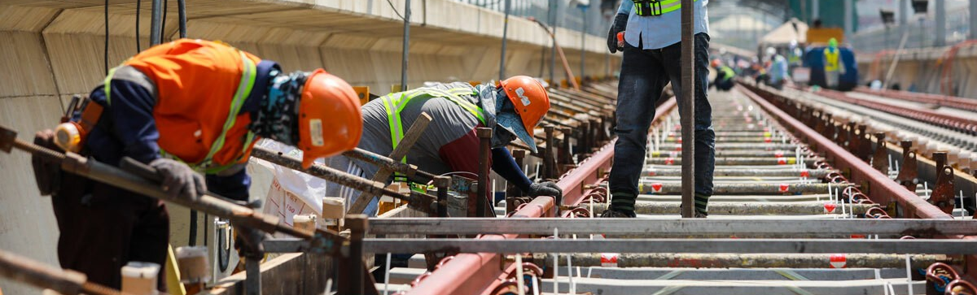
Ho Chi Minh City, Vietnam
A USTDA-funded feasibility study assessed the viability of constructing an integrated operations center (IOC) for the Ho Chi Minh City Metro.
The study included technical specifications, project cost estimates, and a preliminary implementation plan to prepare the project sponsors for financing and implementation.

Slide 7




Connect with USTDA
Verinda Fike
Regional Director for the Indo-Pacific
USTDA — Washington, D.C.
vfike@ustda.gov
Brandon Megorden
USTDA Regional Manager for Asia
U.S. Embassy — Bangkok
bmegorden@ustda.gov
Kevin Toohers
Country Manager, Indo-Pacific Region
Surface Transportation Lead
USTDA – Washington, D.C.
ktoohers@ustda.gov
www.ustda.gov | +1 703-875-4357
1101 Wilson Blvd. Suite 1100
Arlington, VA 22209

