Slide 1
U.S.-ASEAN Smart Cities Partnership Program Overview
as of 4.07.22
Program Manager: Helen Santiago Fink, santiagofinkh@state.gov
www.usasean.org
Notes:
Weekly Update - 27 July 2018

Slide 2
U.S.-ASEAN Smart Cities Partnership Whole of Government Approach
~ Launched in 2018: $13M portfolio, 23 projects with USG and partners;
To adddress ASEAN urban challenges to improve quality of life through: Knowledge sharing, industry practices, expert engagements across urban sectors, eg: water, transport, health, energy, etc.
Climate Action and Finance: strengthen sub-national climate action thru net-zero/low-carbon urban systems and innovative solutions for mitigation and urban resiliency; financing thru Smart Cities Business Innovation Fund
Green Economic Recovery: circular economy for resource recovery/reuse for sustainability and resiliency, eg: Integrated Urban Services Project (OES/NREL);
Increased U.S. and ASEAN Private Sector Engagement: through Commerce activities and seed capital for small businesses/partnerships thru Smart Cities Business Innovation Fund;
Notes:
Smart Cities Business Innovation Fund – RFP, https://asean.usmission.gov/smart-cities-business-innovation-fund/
https://www.state.gov/connecting-climate-entrepreneurs-cce/

Slide 3
Notes:
New urban paradigm - part of the biosphere
A City is a microcosm of the global needs and challenges …. “creating jobs, solving global problems that affect our residents, offering young Angelenos global skills and experiences, and supporting our domestic and foreign partners. We create jobs by facilitating foreign direct investment, encouraging new nonstop flights, conducting trade missions and assisting exporters.”
Nina Hachigian, Los Angeles’ first deputy mayor for international affairs, Ambassador to ASEAN 2014 to 2017
https://afsa.org/local-governments-are-foreign-policy-actors-too?_zs=p7lkd1&_zl=UUs88
Human development cannot be decoupled/separate from the biosphere – even with the dependency on technology – for tech itself is dependent of the biosphere and Earth system for its existence. .

Slide 4
Indo-Pacific ASEAN Trends
Urbanization
Climate Change
Biodiversity Loss
Dam Construction
Health Impacts
Fourth Industrial Revolution
Notes:
Urbanization: resource footprint (waste); congestion and urban sprawl, technology/ICT use
4th Industrial Revolution: the Fourth Industrial Revolution refers to how technologies like artificial intelligence, autonomous vehicles and the internet of things are merging with humans’ physical lives. Think of voice-activated assistants, facial ID recognition or digital health-care sensors. …blurring the lines between the physical, digital and biological spheres.. Symbiosis of technology and society..

Slide 5
Smart Sustainable Cities Tools
Comprehensive Urban Planning
Sustainable, Biophilic/Green Design
Policy – forward-looking
Innovation, technology and ICT
Nature-based Solutions, eg: Green Infrastructure, bio-retention parks
New Economic/Financing Models Circular Economy Principles
Communication and Governance Structures, eg: e-government

Slide 6
VALUE OF INTEGRATED MASTER PLANNING AND DEVELOPMENT Chattanooga Climate Action Plan:(before (top photo) and after (bottom):​ - Energy Efficiency - Education and Policy - Healthy Communities - Natural Resources

Slide 7
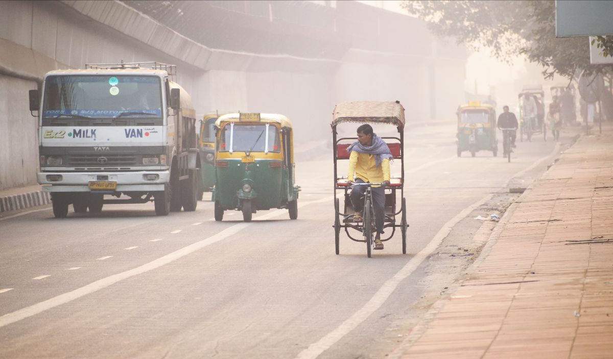
PUBLIC HEALTH Solutions - Air pollution kills more people than tuberculosis, HIV/AIDS, and malaria combined - Nature-based solutions, eg: green buffers, street trees, can support PM 2.5/10 capture and mitigate heat island through evapotranspiration processes. - Health focused urban planning is essential to mitigate health, safety and socio-economic risks.

Slide 8
U.S.-ASEAN Smart City Partnership (USASCP) Overview: Program Name, Focus and Approach | Implementing Partners | Target Country/City
 |  | (and city pairing)
Transport: Sustainable Mobility (focused on Policy, Planning and Technology solutions) | DOT | Phnom Penh, Cambodia - Boston​, MA
 |  | Jakarta, Indonesia - Los Angeles, CA
City pairings
City pairings |  | Johor Bahru, Malaysia-Portland Oregon
and university partners
 |  | Kuala Lumpur, Malaysia - Dallas, Texas
 |  | Phuket, Thailand – Las Vegas Nevada
Water: Water Smart Engagements (WiSE) | OES, U.S. Water Partnership | Thailand/Phuket–Milwaukee Wisconsin
(focused on drinking water and wastewater treatment - working with utilities) |  | HCMC, Vietnam - San Francisco, CA
 |  | Johor Bahru, Malaysia – Washington, DC
City pairings |  | Vientiane, Laos – Hillsboro Oregon
 |  | Cebu, Philippines - Honolulu Hawaii
 |  | Cebu, Philippines – Miami- Dade
Research and Innovation | NSF/National Science Foundation, university partners
 |  | Jakarta/Makassar, Indonesia
 |  | Singapore
 |  | Kuala Lumpur Malaysia
 |  | HCMC (2) Vietnam
 |  | Manila, Philippines/Manila
Systems Integration: Integrated Urban Services (IUS) | OES, NREL/National Renewable Energy Labs | ASEAN and two pilot cities (tbc)
Notes:
Good representation in Mekong Cities; all countries less Myanmar.

Slide 10
Promoting Research and Innovation
via NSF Grants
National Science Foundation Research (NSF) Grants | City/Country | University Partners
Mobility/Energy Generation: Renewable Energy Bike Lanes (with embedded PV cells); NSF ID 2025641 | Kuala Lumpur, Malaysia | Prairie View A&M University, University Tenaga Nasional (UNITEN)
Smart Garden Alleys: Micro-Climate Data Collection and Optimization (builds upon USAID project); NSF ID 2025459 | Makassar City, Indonesia | University of Colorado, Virginia Tech, Universitas Gadjah Mada, Institut Teknologi Bandung
Digital/Gig Economy: Regional Big Data Analysis of Air Pollution NSF ID 2025022 | Thailand, Manila, Jakarta, Singapore | University of Washington, National University of Singapore, University of the Philippines
Transportation Planning: Crowd AI sensing Traffic Analysis and Simulation; NSF ID 2025234 | Ho Chi Minh city (HCMC), Vietnam | University of Dayton, Vietnam National University – Ho Chi Ming City
e-Government: Distributed Data-Sharing and Decision Support; NSF ID 2026050 | Ho Chi Minh city (HCMC), Vietnam | University of Virginia, Vietnam National University – Ho Chi Ming City

Slide 11
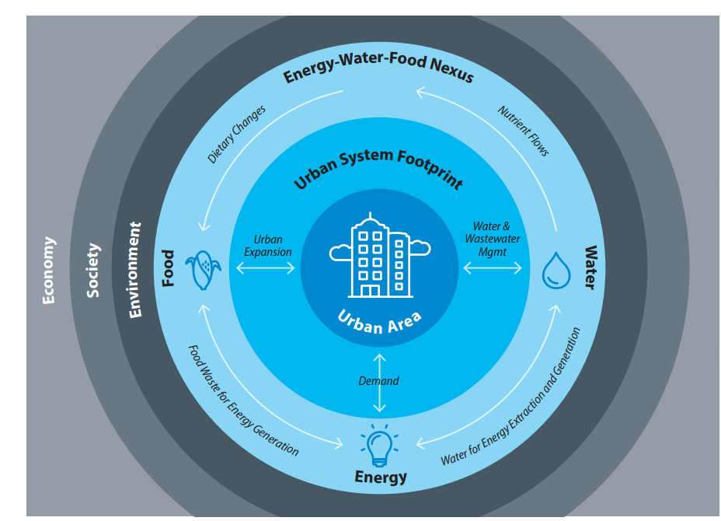
Integrated Urban Services Program https://www.nrel.gov/international/integrated-urban-services.html
Integrated Urban Services (IUS) is helping ASEAN cities build resilience in their energy, water, and food provisioning systems.
Jointly implemented by State and the U.S. Department of Energy’s National Renewable Energy Laboratory (NREL), with an aim to promote systems integration and circular economy principles for resource recovery and reuse
Pilot projects in Cagayan de Oro Philippines and Iskandar Malaysia

Slide 12
Smart Cities Business Innovation Fund, https://asean.usmission.gov/smart-cities-business-innovation-fund/
Amount of Funding: A minimum of $30,000 USD and a maximum of $300,000 USD per award. The total amount available for awards is $1,000,000 USD.
Eligibility to Apply: Stakeholders (small businesses, NGOs and universities) from ASEAN Cities and eligible countries: Cambodia and Laos (environment and health projects only) Indonesia, Malaysia, Philippines, Thailand, and Vietnam
Proposals must offer a sustainable net-zero/low carbon solution to address a documented urban challenge. Solutions may be technological, nature-based, financial, organizational, or take another form to meet a documented urban challenge (supported by local planning documents, government policies, university research, etc.)
Notes:
Dissemination of Request for Proposals (RFP) of the USASCP Smart Cities Business Innovation Fund, a funding scheme for net-zero/low carbon solutions to address urban challenges. A total of $1 million is available to fund proposals, between $30,000 to $300,000 per proposal. Posts are requested to share the website for submitting applications with relevant contacts. The application deadline is April 3, 2022. https://asean.usmission.gov/smart-cities-business-innovation-fund/

Slide 13
New Programming under Develoment
Professional Exchange Program on Circular Waste Management –
Study tour: Oct.3-14, 2022,
Singapore and Washington, DC ​
Green Buildings Innovation
Launch date:
~Sept. 1-7, 2022,
Singapore

Slide 14
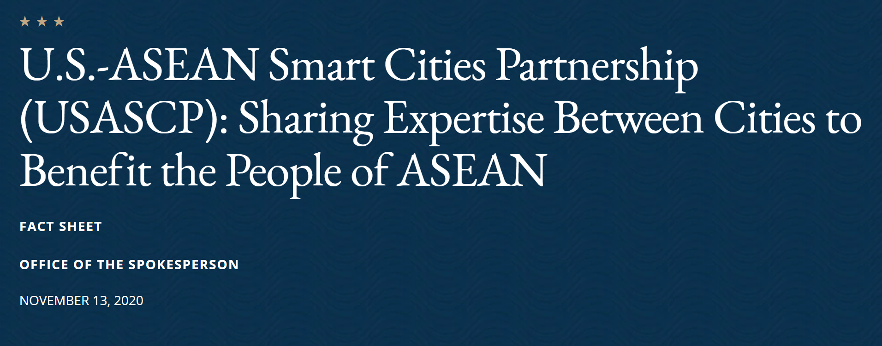
* USASCP Fact Sheet * Coordination with Japan * Strategic Partnership with Singapore and Growth and Innovation
https://www.state.gov/u-s-asean-smart-cities-partnership-usascp-sharing-expertise-between-cities-to-benefit-the-people-of-asean/
https://2017-2021.state.gov/joint-statement-by-the-united-states-and-japan-on-furthering-the-development-of-smart-cities-in-the-indo-pacific/index.html (archived)
https://www.whitehouse.gov/briefing-room/statements-releases/2021/08/23/fact-sheet-strengthening-the-u-s-singapore-strategic-partnership/
https://www.commerce.gov/news/press-releases/2021/11/us-singapore-partnership-growth-and-innovation-joint-statement-us

Slide 15
Additional USASCP Engagements
2021 YSEALI Smart Cities Regional Workshop: “Urban System Integration and Nature-based Solutions For Sustainability”
2021 Third Country Training Program (TCTP) with Singapore: “Addressing plastic pollution through integrated waste management strategies and circular economic models ”
* 2021 Diplomacy Lab with Indiana University - Bloomington: “Green Economic Recovery and Smart Sustainable Cities”

