Slide 1

Modeling Cities in Decarbonization Pathways
Notes:
Stock Image

Slide 2
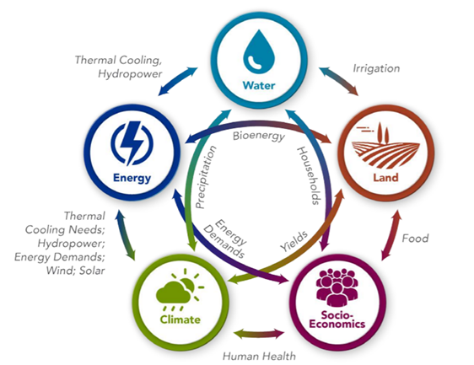
Importance of Integrated Analysis
Integrated analysis is valuable in understanding city decarbonization choices.
  Covers many sectors and explores connections between these sectors and the environment
  Highlights tradeoffs of different policies and explores “what-if” scenarios
  Helps identify the most beneficial decarbonization pathways at the city and national level
These factors allow cities to explore socioeconomic and environmental consequences of policies and cross-sector implications.
This contributes to informed, sustainable decision making at the city level.
An overview of the systems within the Global Change Analysis Model. (Image source: https://gcims.pnnl.gov)

Slide 3
GCAM City Scale Modeling Framework
National
City
Subnational downscaling
Agriculture production and consumption
Water consumption and land use change
Buildings
Industry
Population
Primary Energy Supply
Transportation
GDP
Electricity Generation
Rest of Country
Refining & other energy transformation
Buildings
Population
Industry
GDP
Final Energy Supply
Transportation
3

Slide 4
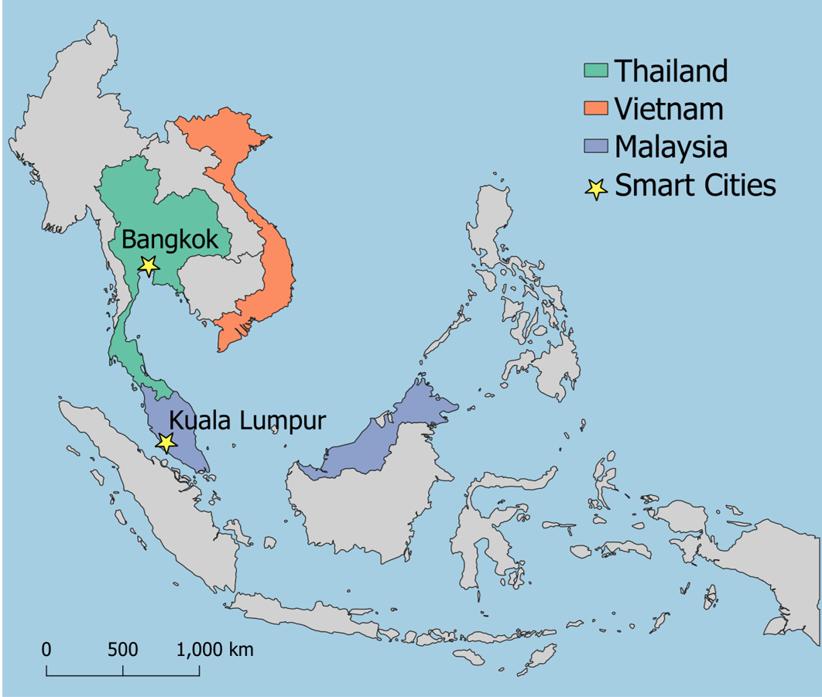
Applications for Regional Analysis
This pilot project focuses on Kuala Lumpur, Malaysia and Bangkok, Thailand. The framework of this analysis can be applied to additional cities in ASEAN member states and worldwide.
This analysis will help inform city leaders in long term decision-making as they outline future climate and energy system goals.
Cities play an important role in decarbonization, and through meaningful stakeholder engagement and capacity building, this project helps enable smart city development in a net-zero context.
A map showing the location of the Smart Cities included in this pilot project.
(Figure by Taryn Waite | Pacific Northwest National Laboratory)

Slide 5
Pilot City: Bangkok, Thailand
Stakeholder engagement
Key policies, plans, and goals
City level
Bangkok Metropolitan Administration
Metropolitan Electricity Authority
Thammasat University
Bangkok Master Plan on Climate Change
  10.15 MtCO₂eq reduction by 2030
Smart City Development Plans
Smart Grid Development Plans
National level
Energy Policy and Planning Office
Electricity Generating Authority of Thailand
Thailand Long Term Strategy
  Carbon neutral 2050; Net-zero GHG 2065
Power Development Plan
Energy Efficiency Plan
5

Slide 6
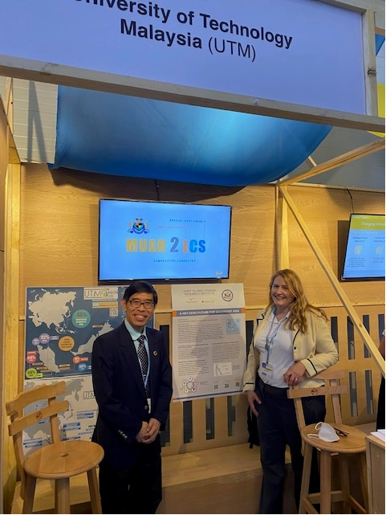
Pilot City: Kuala Lumpur, Malaysia
Stakeholder engagement
Kuala Lumpur City Hall
University of Technology Malaysia
Key policies, plans, and goals
Kuala Lumpur Low Carbon Society Blueprint 2030
Kuala Lumpur Structure Plan 2040
Kuala Lumpur Climate Action Plan 2050
6

Slide 7
Scenario Design
Power
Wind & solar development
Coal phase-out
Smart Grid policies
Buildings
Envelope efficiency
Lighting & air conditioner efficiency
Smart Grid policies
Transportation
Electric vehicles
Combustion engine vehicle phase-out
Public transportation
Industry
Industrial energy efficiency
Hydrogen technology development
Sectoral Policies
Emissions Constraints
Business as usual
GCAM reference scenario (no added policies)
Carbon Neutrality
2050
Low (high) ambition
Low (high) ambition in city and rest of country
Net-Zero GHG Emissions
2065
Ambitious city
High ambition in city; low ambition in rest of country

Slide 8
Insights from GCAM Results
BAU
Sectoral Policies
+ Emissions Constraints
Mitigating residual emissions
Greater ambition in sectoral policies
Land use change
Hydrogen
Carbon capture, use, and storage (CCUS)
Bioenergy with carbon capture and storage (BECCS)
Power
Buildings
CO₂ emissions in 2050
Transport
Industry
?
City
?
Residual Emissions
?
Rest of Country

Slide 9
Insights from GCAM Results
How can Smart City policies contribute to decarbonization goals? Which policies will have the most impact?
Sector | Result
All | CO₂ and GHG emissions by sector and by gas
Power | Electricity prices
Power | Electricity generation by technology
Buildings | Residential & commercial energy & electricity consumption
Transport | Service output and energy consumption by technology & fuel
Industry | Industrial energy consumption by fuel, including electricity
To what extent do the cities contribute to national emissions?
How will the shift to renewable energy impact electricity prices?
How can distributed solar contribute to power supply in the cities?
How will electricity and energy demand change as technology shares shift?

Slide 10
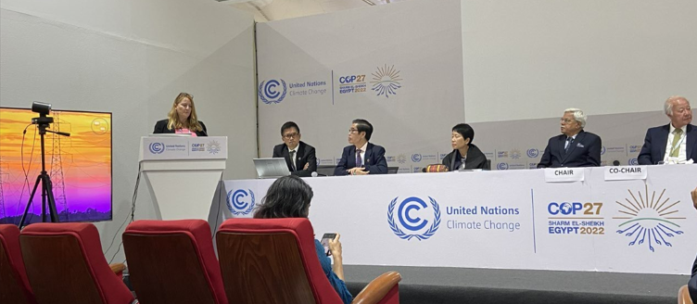
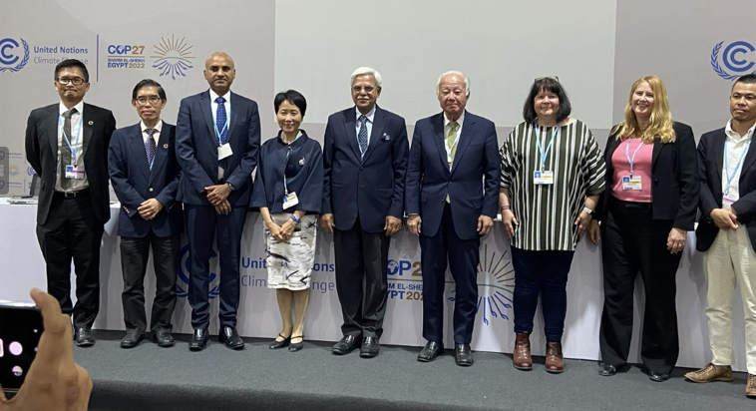
Takeaways from COP27 Events
COP Engagement:
  Official side event: How Can Asia Achieve a Net Zero Future? Building Coalitions for Transformative Change
    Presentations by PNNL and UTM on smart cities efforts
  Booth with UTM of Malaysia that showcased decarbonization analysis in Kuala Lumpur, among other topics
Impacts:
  Significant interest from side event
    Follow on webinar for Asian audience in collaboration with Japan: Achieving a Net-Zero Future in Asia: From Individual Innovation to Societal Transformation, ISAP2022, IGES (11/29/22)
    Interest from TERI staff and other Indian participants in replication efforts in India
  Booth and poster impacts
    Numerous COP participants from around the world asked questions about smart city collaboration in Kuala Lumpur, with interest to replicate it
      Other ASEAN countries, sub-Saharan Africa (e.g., Lusaka’s mayor), other geographies
Notes:
ISAP: International Forum for Sustainable Asia and the Pacific; IGES: Institute for Global Environmental Strategies (Japan); TERI: The Energy and Resources Institute

